Slide 1

Chapter 2 Bits, Data Types,and Operations
An Hong han@ustc.edu.cn
2016 Fall
Lecture on
Introduction to Computing Systems
（01170401）
School of Computer Science and Technology

Slide 2
Review
Great Ideas in Computing Systems
  Great Idea #1: Computer is an Universal Computing Device
  Great Idea #2 存储程序计算机(Von Neumann Model)
  Great Idea #3: Abstraction Helps Us Manage Complexity
  Great Idea #4 Software and Hardware Co-design

Slide 3
Today
How do we represent data in a computer?
Integer Data Types
2’Complement Integers
Binary-Decimal Conversion
Application
Algorithm and Data Structure
Programming Language/Compiler
Operating System/Virtual Machines
Instruction Set Architecture (ISA)
Microarchitecture
Gates/Register-Transfer Level (RTL)
Analog/Digital Circuits
Electronic Devices
Physics

Slide 4

Bottom up approach
Now, You are Here.
Transistor

Slide 5

Big Idea #2: How do we get the electrons to do the work?
Application
Algorithm & Data Structure
Language
Software
指令集体系结构 (Machine Architecture, ISA)
Hardware
Microarchiture
Now, You are Here.
Logic and IC
Device
Computer System: Layers of Abstraction
Notes:
5

Slide 6
How do we represent data in a computer?
At the lowest level, a computer is an electronic machine.
  works by controlling the flow of electrons
Easy to recognize two conditions:
  presence of a voltage – we’ll call this state “1”
  absence of a voltage – we’ll call this state “0”
Could base state on value of voltage, but control and detection circuits more complex.
  compare turning on a light switch to measuring or regulating voltage
We’ll see examples of these circuits in the next chapter.

Slide 7
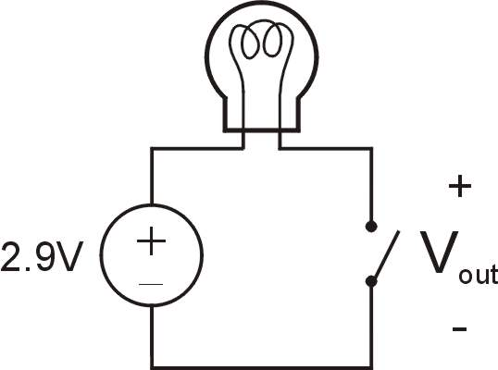
Simple Switch Circuit
Switch open:
  No current through circuit
  Light is off
  V_{out} is +2.9V
Switch closed:
  Short circuit across switch
  Current flows
  Light is on
  V_{out} is 0V
Switch-based circuits can easily represent two states:
on/off, open/closed, voltage/no voltage.
Notes:
7

Slide 8
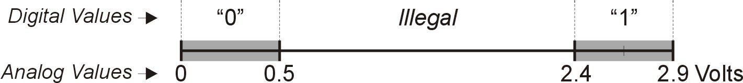
Computer is a binary digital system.
Digital system:
  finite number of symbols
Binary (base two) system:
  has two states: 0 and 1
Basic unit of information is the binary digit, or bit.
Values with more than two states require multiple bits.
  A collection of two bits has four possible states:
  00, 01, 10, 11
  A collection of three bits has eight possible states:
  000, 001, 010, 011, 100, 101, 110, 111
  A collection of n bits has 2^{n} possible states.
Notes:
8

Slide 9


N-type MOS Transistor
Gate = 1
Gate = 0
Terminal #2 must be
connected to GND (0V).
MOS = Metal Oxide Semiconductor
  two types: N-type and P-type
N-type
  when Gate has positive voltage,
  short circuit between #1 and #2
  (switch closed)
  when Gate has zero voltage,
  open circuit between #1 and #2
  (switch open)
Notes:
9

Slide 10
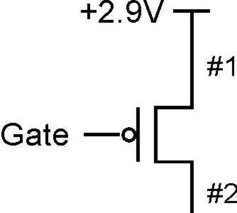
P-type MOS Transistor
Gate = 1
Gate = 0
Terminal #1 must be
connected to +2.9V.
P-type is complementary to N-type
  when Gate has positive voltage,
  open circuit between #1 and #2
  (switch open)
  when Gate has zero voltage,
  short circuit between #1 and #2
  (switch closed)
Notes:
10

Slide 11
Logic Gates
Use switch behavior of MOS transistors
to implement logical functions: AND, OR, NOT.
Digital symbols:
  recall that we assign a range of analog voltages to each
  digital (logic) symbol
  assignment of voltage ranges depends on
  electrical properties of transistors being used
    typical values for "1": +5V, +3.3V, +2.9V, +1.1V
    for purposes of illustration, we'll use +2.9V

Slide 12
What kinds of data do we need to represent?
Kinds of data
  Numbers – signed, unsigned, integers, floating point,
  complex, rational, irrational, …
  Text – characters, strings, …
  Images – pixels, colors, shapes, …
  Sound
  Logical – true, false
  Instructions
  …
Data type: representation and operations within the computer
We’ll start with numbers…
Notes:
12

Slide 13
Unsigned Integers
Non-positional notation
  Could represent a number (“5”) with a string of ones (“11111”) problems?
Weighted positional notation
  like decimal numbers: “329”
  “3” is worth 300, because of its position, while “9” is only worth 9
most
significant
least
significant
329
101
10²
10¹
10⁰
2²
2¹
2⁰
3x100 + 2x10 + 9x1 = 329
1x4 + 0x2 + 1x1 = 5

Slide 14
Unsigned Integers (cont.)
2² | 2¹ | 2⁰
0 | 0 | 0 | 0
0 | 0 | 1 | 1
0 | 1 | 0 | 2
0 | 1 | 1 | 3
1 | 0 | 0 | 4
1 | 0 | 1 | 5
1 | 1 | 0 | 6
1 | 1 | 1 | 7
An n-bit unsigned integer represents 2^{n} values:
from 0 to 2^{n}-1.
Notes:
14

Slide 15
Unsigned Binary Arithmetic
Base-2 addition – just like base-10!
  add from right to left, propagating carry
carry
10010 10010 1111
+ 1001 + 1011 + 1
11011 11101 10000
10111
+ 111
Subtraction, multiplication, division,…
Notes:
15

Slide 16
Signed Integers
With n bits, we have 2^{n} distinct values.
  assign about half to positive integers (1 through 2^{n-1})
  and about half to negative (- 2^{n-1} through -1)
  that leaves two values: one for 0, and one extra
Positive integers
  just like unsigned – zero in Most Significant（MS） bit
  00101 = 5
Negative integers
  sign-magnitude – set top bit to show negative,
  other bits are the same as unsigned
  10101 = -5
  one’s complement – flip every bit to represent negative
  11010 = -5
  in either case, MS bit indicates sign: 0=positive, 1=negative

Slide 17
Two’s Complement
Problems with sign-magnitude and 1’s complement
  two representations of zero (+0 and –0)
  arithmetic circuits are complex
    How to add two sign-magnitude numbers?
      e.g., try 2 + (-3)
    How to add two one’s complement numbers?
      e.g., try 4 + (-3)
Two’s complement representation developed to make
circuits easy for arithmetic.
  for each positive number (X), assign value to its negative (-X),
  such that X + (-X) = 0 with “normal” addition, ignoring carry out
00101 (5) 01001 (9)
+ 11011 (-5) + (-9)
00000 (0) 00000 (0)
Notes:
17
Sign-magnitude 2 + (-3): convert to subtraction based on sign bit
111
0 010 010
+1 011 - 011
----------- ---------
111
result is really: 2 + (-3) + 8 (or 2^3 for last borrow) = 7
So we have to correct by subtracting from 8: 8 – 7 = 1 is correct magnitude
Hence we need to choose add vs subtract based on sign bit
Then we need to correct magnitude if a final borrow occurred
One’s complement:
If (N>M) result should be positive with magnitude N-M
N + {M} = N + (2^n – 1 – M) = (2^n – 1) + (N – M)
So to get N-M we must subtract (2^n – 1) from result,
i.e. throw out the end-carry (2^n) and add one
(end-around carry correction step)
11 000
0 100
+1 100
----------
10 000
(correction step)
+1
---------
0001
If (M>N), e.g. 3 + (-4), result (M-N)
will be negative; expressed as 1’s
complement what we want is 2^n – 1 – (M – N) = N – M + 2^n – 1
Just as above, this is what we get.
0011
+1011
---------
1110 => this is one’s complement of 1, or -1
Hence no correction step is needed, since there was no final
Borrow.

Slide 18
Two’s Complement Representation
00101 (5) 01001 (9)
11010 (1’s comp) (1’s comp)
+ 1 + 1
11011 (-5) (-9)
If number is positive or zero,
  normal binary representation, zeroes in upper bit(s)
If number is negative,
  start with positive number
  flip every bit (i.e., take the one’s complement)
  then add one
Notes:
18
01001 (9)
10110 (1’s c)
+ 1
---------
10111 (-9)
Mathematically, 2^n - M

Slide 19
Two’s Complement Shortcut
011010000 011010000
100101111 (1’s comp)
+ 1
100110000 100110000
(flip)
(copy)
To take the two’s complement of a number:
  copy bits from right to left until (and including) the first “1”
  flip remaining bits to the left
Notes:
19

Slide 20
Two’s Complement Signed Integers
MS bit is sign bit – it has weight –2^{n-1}.
Range of an n-bit number: -2^{n-1} through 2^{n-1} – 1.
  The most negative number (-2^{n-1}) has no positive counterpart.
-2³ | 2² | 2¹ | 2⁰
0 | 0 | 0 | 0 | 0
0 | 0 | 0 | 1 | 1
0 | 0 | 1 | 0 | 2
0 | 0 | 1 | 1 | 3
0 | 1 | 0 | 0 | 4
0 | 1 | 0 | 1 | 5
0 | 1 | 1 | 0 | 6
0 | 1 | 1 | 1 | 7
-2³ | 2² | 2¹ | 2⁰
1 | 0 | 0 | 0 | -8
1 | 0 | 0 | 1 | -7
1 | 0 | 1 | 0 | -6
1 | 0 | 1 | 1 | -5
1 | 1 | 0 | 0 | -4
1 | 1 | 0 | 1 | -3
1 | 1 | 1 | 0 | -2
1 | 1 | 1 | 1 | -1
Notes:
20

Slide 21
Converting Binary (2’s C) to Decimal
If leading bit is one, take two’s complement to get a positive number.
Add powers of 2 that have “1” in the
corresponding bit positions.
If original number was negative,
add a minus sign.
n | 2^{n}
0 | 1
1 | 2
2 | 4
3 | 8
4 | 16
5 | 32
6 | 64
7 | 128
8 | 256
9 | 512
10 | 1024
X = 01101000two
= 2⁶+2⁵+2³ = 64+32+8
= 104ten
Assuming 8-bit 2’s complement numbers.
Notes:
21

Slide 22
More Examples
X = 00100111two
= 2⁵+2²+2¹+2⁰ = 32+4+2+1
= 39ten
n | 2^{n}
0 | 1
1 | 2
2 | 4
3 | 8
4 | 16
5 | 32
6 | 64
7 | 128
8 | 256
9 | 512
10 | 1024
X = 11100110two
-X = 00011010
= 2⁴+2³+2¹ = 16+8+2
= 26ten
X = -26ten
Assuming 8-bit 2’s complement numbers.
Notes:
22

Slide 23
Converting Decimal to Binary (2’s C)
First Method: Division
Divide by two – remainder is least significant bit.
Keep dividing by two until answer is zero,
writing remainders from right to left.
Append a zero as the MS bit;
if original number negative, take two’s complement.
X = 104ten 104/2 = 52 r0 bit 0
52/2 = 26 r0 bit 1
26/2 = 13 r0 bit 2
13/2 = 6 r1 bit 3
6/2 = 3 r0 bit 4
3/2 = 1 r1 bit 5
X = 01101000two 1/2 = 0 r1 bit 6
Notes:
23

Slide 24
Converting Decimal to Binary (2’s C)
n | 2^{n}
0 | 1
1 | 2
2 | 4
3 | 8
4 | 16
5 | 32
6 | 64
7 | 128
8 | 256
9 | 512
10 | 1024
Second Method: Subtract Powers of Two
Change to positive decimal number.
Subtract largest power of two
less than or equal to number.
Put a one in the corresponding bit position.
Keep subtracting until result is zero.
Append a zero as MS bit;
if original was negative, take two’s complement.
X = 104ten 104 - 64 = 40 bit 6
40 - 32 = 8 bit 5
8 - 8 = 0 bit 3
X = 01101000two
Notes:
24

Slide 25
Operations: Arithmetic and Logical
Recall:
a data type includes representation and operations.
We now have a good representation for signed integers,
so let’s look at some arithmetic operations:
  Addition
  Subtraction
  Sign Extension
We’ll also look at overflow conditions for addition.
Multiplication, division, etc., can be built from these
basic operations.
Logical operations are also useful:
  AND
  OR
  NOT
Notes:
25

Slide 26
Addition
As we’ve discussed, 2’s comp. addition is just
binary addition.
  assume all integers have the same number of bits
  ignore carry out
  for now, assume that sum fits in n-bit 2’s comp. representation
01101000 (104) 11110110 (-10)
+ 11110000 (-16) + (-9)
01011000 (88) (-19)
Assuming 8-bit 2’s complement numbers.
Notes:
26
11110110 (-10)
11110111 (-9)
----------------------
11101101 (-19)
Check: {11101101} = 00010011 = 16 + 2 + 1 = 19, or
-128+64+32+8+4+1 = 19

Slide 27
Subtraction
Negate subtrahend (2nd no.) and add.
  assume all integers have the same number of bits
  ignore carry out
  for now, assume that difference fits in n-bit 2’s comp. representation
01101000 (104) 11110110 (-10)
- 00010000 (16) + (-9)
  01101000 (104) 11110110 (-10)
+ 11110000 (-16) + (9)
01011000 (88) (-1)
Assuming 8-bit 2’s complement numbers.
Notes:
27
11110110 (-10)
11110111 (-9)
----------------------
11101101 (-19)
11110110 (-10)
00001001 (9)
----------------------
11111111 (-1)

Slide 28
Sign Extension
4-bit 8-bit
0100 (4) 00000100 (still 4)
1100 (-4) 00001100 (12, not -4)
4-bit 8-bit
0100 (4) 00000100 (still 4)
1100 (-4) 11111100 (still -4)
To add two numbers, we must represent them
with the same number of bits.
If we just pad with zeroes on the left:
Instead, replicate the MS bit -- the sign bit:
Notes:
28

Slide 29
Overflow
If operands are too big, then sum cannot be represented as an n-bit 2’s comp number.
We have overflow if:
  signs of both operands are the same, and
  sign of sum is different.
Another test -- easy for hardware:
  carry into MS bit does not equal carry out
01000 (8) 11000 (-8)
+ 01001 (9) + 10111 (-9)
10001 (-15) 01111 (+15)
Notes:
29

Slide 30
Logical Operations
A | B | A AND B
0 | 0 | 0
0 | 1 | 0
1 | 0 | 0
1 | 1 | 1
A | B | A OR B
0 | 0 | 0
0 | 1 | 1
1 | 0 | 1
1 | 1 | 1
A | NOT A
0 | 1
1 | 0
Operations on logical TRUE or FALSE
  two states -- takes one bit to represent: TRUE=1, FALSE=0
View n-bit number as a collection of n logical values
  operation applied to each bit independently
Notes:
30

Slide 31
Examples of Logical Operations
11000101
AND 00001111
00000101
11000101
OR 00001111
11001111
NOT 11000101
00111010
AND
  useful for clearing bits
    AND with zero = 0
    AND with one = no change
OR
  useful for setting bits
    OR with zero = no change
    OR with one = 1
NOT
  unary operation -- one argument
  flips every bit
Notes:
31

Slide 32
Hexadecimal Notation
Binary | Hex | Decimal
0000 | 0 | 0
0001 | 1 | 1
0010 | 2 | 2
0011 | 3 | 3
0100 | 4 | 4
0101 | 5 | 5
0110 | 6 | 6
0111 | 7 | 7
Binary | Hex | Decimal
1000 | 8 | 8
1001 | 9 | 9
1010 | A | 10
1011 | B | 11
1100 | C | 12
1101 | D | 13
1110 | E | 14
1111 | F | 15
It is often convenient to write binary (base-2) numbers
as hexadecimal (base-16) numbers instead.
  fewer digits -- four bits per hex digit
  less error prone -- easy to corrupt long string of 1’s and 0’s
Notes:
32

Slide 33
Converting from Binary to Hexadecimal
Every four bits is a hex digit.
  start grouping from right-hand side
011101010001111010011010111
3
A
8
F
4
D
7
This is not a new machine representation,
just a convenient way to write the number.
Notes:
33

Slide 34
Fractions: Fixed-Point
n | 2^{n}
0 | 1
1 | 2
2 | 4
3 | 8
4 | 16
5 | 32
6 | 64
7 | 128
8 | 256
9 | 512
10 | 1024
2⁻¹ = 0.5
2⁻² = 0.25
2⁻³ = 0.125
00101000.101
+ 11111110.110
00100111.011
(40.625)
+ (-1.25)
(39.375)
No new operations -- same as integer arithmetic.
How can we represent fractions?
  Use a “binary point” to separate positive
  from negative powers of two -- just like “decimal point.”
  2’s comp addition and subtraction still work.
    if binary points are aligned
Notes:
34

Slide 35
Very Large and Very Small: Floating-Point
1b
8b
23b
S
Exponent
Fraction
Large values: 6.023 x 10²³ -- requires 79 bits
Small values: 6.626 x 10⁻³⁴ -- requires >110 bits
Use equivalent of “scientific notation”: F x 2E
Need to represent F (fraction), E (exponent), and sign.
IEEE 754 Floating-Point Standard (32-bits):
Notes:
35

Slide 36
Floating Point Example
sign
exponent
fraction
Single-precision IEEE floating point number:
10111111010000000000000000000000
  Sign is 1 – number is negative.
  Exponent field is 01111110 = 126 (decimal).
  Fraction is 0.100000000000… = 0.5 (decimal).
Value = -1.5 x 2⁽¹²⁶⁻¹²⁷⁾ = -1.5 x 2⁻¹ = -0.75.
Notes:
36

Slide 37
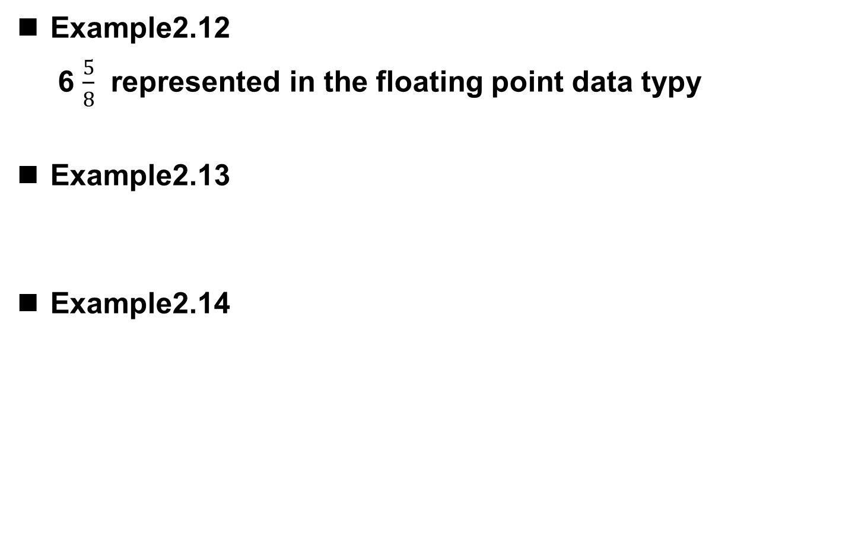
Floating Point Example

Slide 38
Floating-Point Operations
Will regular 2’s complement arithmetic work for
Floating Point numbers?
(Hint: In decimal, how do we compute 3.07 x 10¹² + 9.11 x 10⁸?)

Slide 39
Text: ASCII Characters
00 | nul | 10 | dle | 20 | sp | 30 | 0 | 40 | @ | 50 | P | 60 | ` | 70 | p
01 | soh | 11 | dc1 | 21 | ! | 31 | 1 | 41 | A | 51 | Q | 61 | a | 71 | q
02 | stx | 12 | dc2 | 22 | " | 32 | 2 | 42 | B | 52 | R | 62 | b | 72 | r
03 | etx | 13 | dc3 | 23 | # | 33 | 3 | 43 | C | 53 | S | 63 | c | 73 | s
04 | eot | 14 | dc4 | 24 | $ | 34 | 4 | 44 | D | 54 | T | 64 | d | 74 | t
05 | enq | 15 | nak | 25 | % | 35 | 5 | 45 | E | 55 | U | 65 | e | 75 | u
06 | ack | 16 | syn | 26 | & | 36 | 6 | 46 | F | 56 | V | 66 | f | 76 | v
07 | bel | 17 | etb | 27 | ' | 37 | 7 | 47 | G | 57 | W | 67 | g | 77 | w
08 | bs | 18 | can | 28 | ( | 38 | 8 | 48 | H | 58 | X | 68 | h | 78 | x
09 | ht | 19 | em | 29 | ) | 39 | 9 | 49 | I | 59 | Y | 69 | i | 79 | y
0a | nl | 1a | sub | 2a | * | 3a | : | 4a | J | 5a | Z | 6a | j | 7a | z
0b | vt | 1b | esc | 2b | + | 3b | ; | 4b | K | 5b | [ | 6b | k | 7b | {
0c | np | 1c | fs | 2c | , | 3c | < | 4c | L | 5c | \ | 6c | l | 7c | |
0d | cr | 1d | gs | 2d | - | 3d | = | 4d | M | 5d | ] | 6d | m | 7d | }
0e | so | 1e | rs | 2e | . | 3e | > | 4e | N | 5e | ^ | 6e | n | 7e | ~
0f | si | 1f | us | 2f | / | 3f | ? | 4f | O | 5f | _ | 6f | o | 7f | del
ASCII: Maps 128 characters to 7-bit code.
  both printable and non-printable (ESC, DEL, …) characters
Notes:
39

Slide 40
Interesting Properties of ASCII Code
What is relationship between a decimal digit ('0', '1', …)
and its ASCII code?
What is the difference between an upper-case letter
('A', 'B', …) and its lower-case equivalent ('a', 'b', …)?
Given two ASCII characters, how do we tell which comes first in alphabetical order?
Are 128 characters enough?
(http://www.unicode.org/)
No new operations -- integer arithmetic and logic.

Slide 41
Other Data Types
Text strings
  sequence of characters, terminated with NULL (0)
  typically, no hardware support
Image
  array of pixels
    monochrome: one bit (1/0 = black/white)
    color: red, green, blue (RGB) components (e.g., 8 bits each)
    other properties: transparency
  hardware support:
    typically none, in general-purpose processors
    MMX -- multiple 8-bit operations on 32-bit word
Sound
  sequence of fixed-point numbers

Slide 42
LC-3 Data Types
Some data types are supported directly by the
instruction set architecture.
For LC-3, there is only one supported data type:
  16-bit 2’s complement signed integer
  Operations: ADD, AND, NOT
Other data types are supported by interpreting
16-bit values as logical, text, fixed-point, etc.,
in the software that we write.
Notes:
42

